Slide 1
ENGINEERING ECONOMY
Factors and their Use

Slide 2
Single payment factors: F/P & P/F
We develop a formula which allows us to determine the future amount of money F that is accumulated after n years (or periods) from a single investment P when an interest period is compounded one time per year (period).
Compound interest is charging interest on interest.
Therefore if an amount of money P is invested at some time t=0, the amount of money F₁ that will be accumulated 1 year, at an interest rate i :
F₁ = P + Pi
= P(1 + i)
F₂ = F₁ + F_{1i} = P (1+i) + P (1+i)i
=P (1 + 2i + i²)
= P(1+ i)²
F₃ = F₂ + F₂i
= P(1+ i)² + [P(1+ i)² ]i
F₃= P (1 + i)³
From mathematical induction, the formula can be
generalised for n number of years as:
F = P (1 + i)^{n}
The component (1 + i)^{n} is what is known as the
Single-payment compound-amount factor (SPCAF) also usually called F/P. When the factor is multiplied by P it yield the future amount.

Slide 3
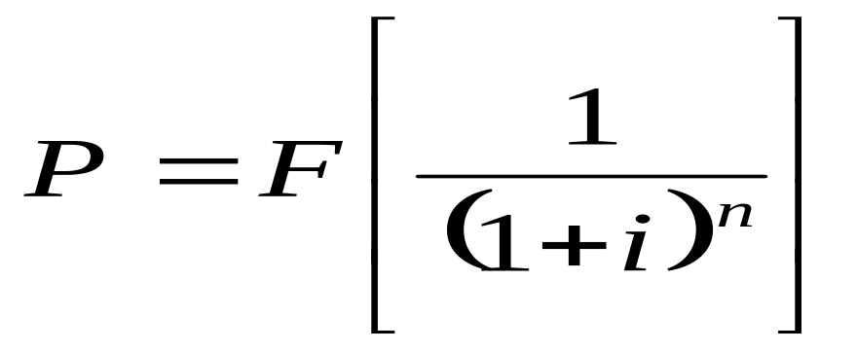
P/F factor
Solving for P in the last equation in terms of F results in the expression:
The expression in the brackets is known as the single payment present-worth factor (SPPWF), or the P/F factor

Slide 4
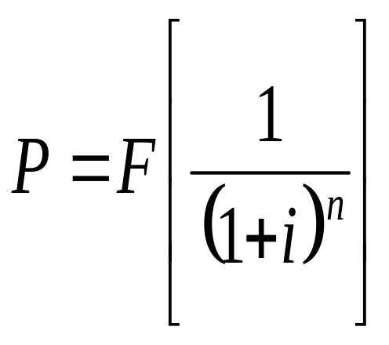
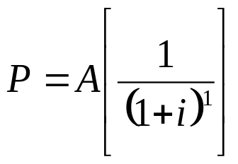
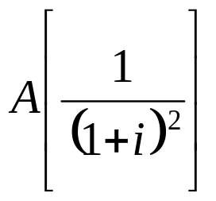
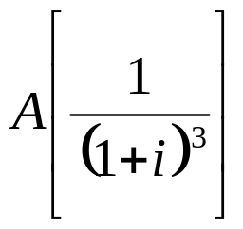
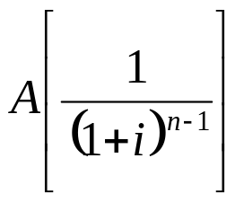
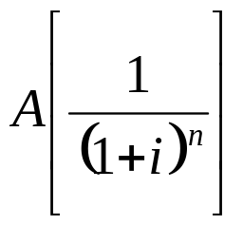
Uniform series
The present worth P of a uniform series can be determined by considering each A value as a future worth F and using the equation with the P/F factor and then summing the present-worth values. The general formula is
+
+
+
+....

Slide 5
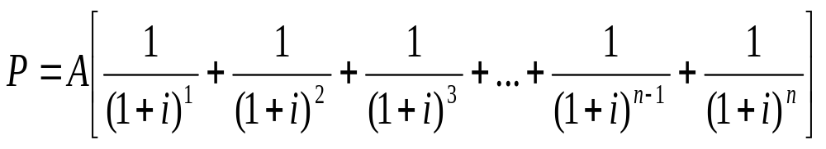
Uniform series
where the terms in brackets represent the P/F factors for years 1 through n respectively. Factoring out A, (eq.4)

Slide 6
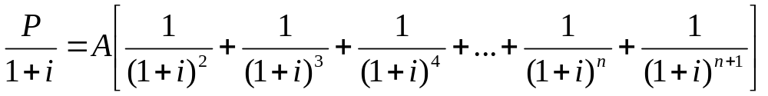
Uniform series
The equation 4 may be simplified by multiplying both sides of the equation by the (P/F,i%,1) factor which is 1/(1 + i)
(Eq. 5)

Slide 7
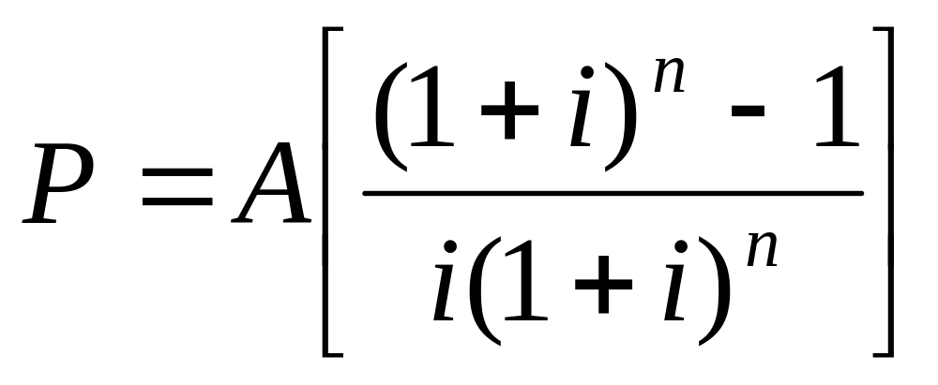
Uniform series
Subtracting equation 4 from equation 5, simplifying, to obtain the expression for P when i ≠ 0
and then dividing both sides of the relation by -i/(1 + i) leads to an expression for P when i ≠ 0

Slide 8
Uniform-series
The term in brackets is called the Uniform-series present-worth factor (USPWF), or P/A factor.
This equation will give the present worth P of an equivalent uniform annual series A which begins at the end of year 1 and extends for n years at an interest rate i.

Slide 9
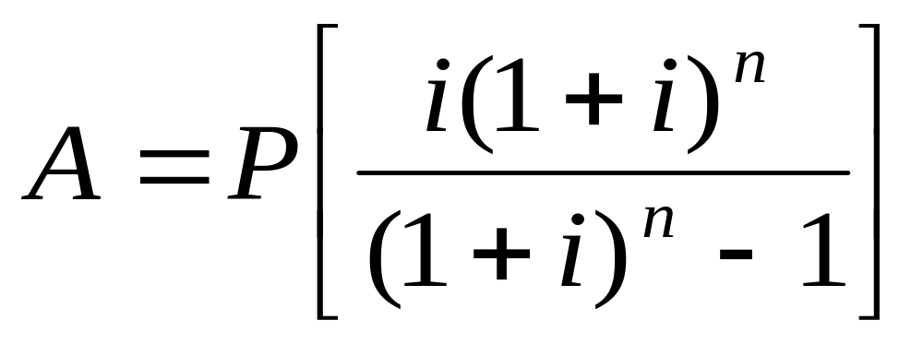
Uniform Series
Rearranging the P/A factor we get the Capital Recovery Factor (CRF) or the A/P factor
This yields the equivalent uniform annual worth A over n years of a given investment P when the interest rate is i.

Slide 10
P/A and A/P FACTORS
It is very important to remember that these formulas are derived with the present worth P and the first uniform annual amount (A) one year (period) apart.
That is the present worth P must always be located one period prior to the first A.

Slide 11
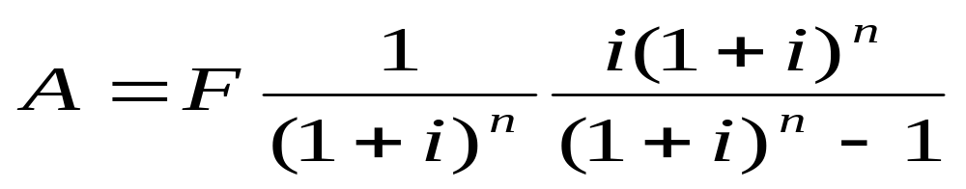
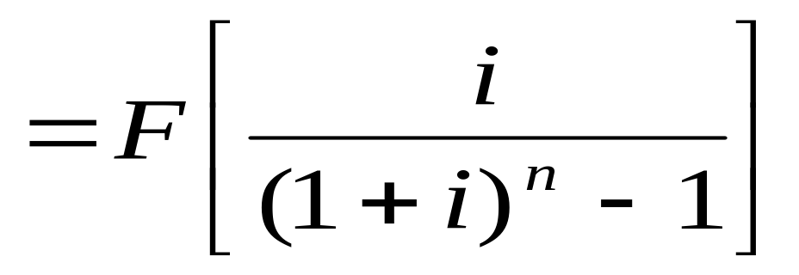
Sinking fund factor and Uniform-series compound-amount factor (A/F and F/A)
The simplest way to derive the formulas is to substitute into those already developed. Thus, if P from equation for P/F is substituted into equation for A/P, the following formula results:

Slide 12
Uniform series
The expression in brackets is the sinking fund, or A/F, factor.
It is use to determine the uniform annual worth series that would be equivalent to a given future worth F.
Note that the uniform series A begins at the end of period 1 and continues through the period of the given F.

Slide 13
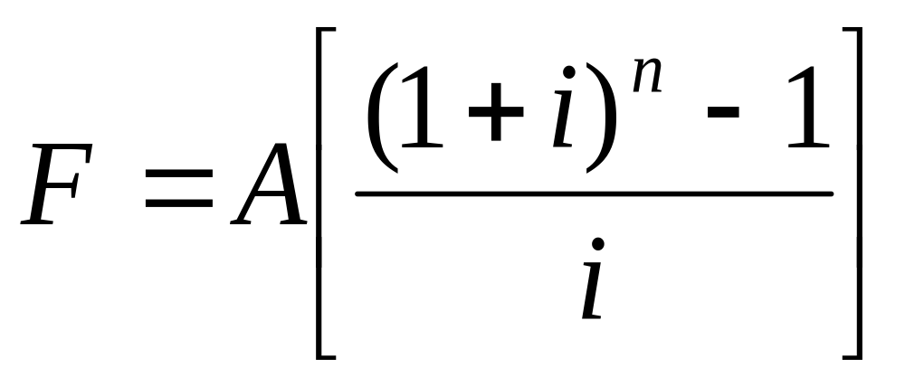
Uniform Series
Rearranging to express F in terms of A, we get the equation below. The term in bracket is the
Uniform Series Compound Amount Factor (USCAF) or F/A factor

Slide 14
F/A factor
The uniform series compound amount factor (USCAF), or F/A factor when multiplied by a given uniform annual amount A, will yield the future worth of the uniform series.
It is important to note that the future amount F occurs in the same period as the last A.

Slide 15
Standard Factor notation and the use of interest tables
A standard notation has been adopted which includes the interest rate and the number of periods and is always in the general form:
(X/Y, i, n)
X represents what is to be found
Y represents what is given
i is the interest rate in percent
n is the number of periods involved

Slide 16
Standard Factor notation and the use of interest tables
(F/P, 6%, 20)
means obtain the factor which when multiplied by a given P allows you to find the future amount of money F that will be accumulated in 20 periods if the interest rate is 6% per period.

Slide 17
Standard Factor notation and the use of interest tables
Factor Name and Standard Notation
Single payment present-worth (SPPWF) or the P/F (P/F, i, n)
Single payment compound amount (SPCAF) or the F/P (F/P, i, n)
Uniform-series present-worth (USPWF), or P/A.(P/A, i, n)
Capital recovery factor (CRF), or the A/P(A/P, i, n)
Sinking fund, or A/F(A/F, i, n)
Uniform series compound amount (USCAF), or F/A(F/A, i, n)

